Slide 1
Wireless DAQ Systems
(Wireless Data Acquisition System)

Slide 2
What Is Data Acquisition?
Data acquisition (DAQ) is the process of measuring an electrical or physical phenomenon such as voltage, current, temperature, pressure, or sound with a computer. A DAQ system consists of sensors, DAQ measurement hardware, and a computer with programmable software. Compared to traditional measurement systems, PC-based DAQ systems exploit the processing power, productivity, display, and connectivity capabilities of industry-standard computers providing a more powerful, flexible, and cost-effective measurement solution.

Slide 3
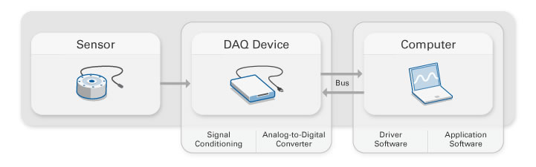
Parts of a DAQ System

Slide 4

What is a Sensor ?
The measurement of a physical phenomenon, such as the temperature of a room, the intensity of a light source, or the force applied to an object, begins with a sensor. A sensor, also called a transducer, converts a physical phenomenon into a measurable electrical signal. Depending on the type of sensor, its electrical output can be a voltage, current, resistance, or another electrical attribute that varies over time. Some sensors may require additional components and circuitry to properly produce a signal that can accurately and safely be read by a DAQ device.

Slide 5

What is a DAQ Device?
DAQ hardware acts as the interface between a computer and signals from the outside world. It primarily functions as a device that digitizes incoming analog signals so that a computer can interpret them. The three key components of a DAQ device used for measuring a signal are the signal conditioning circuitry, analog-to-digital converter (ADC), and computer bus. Many DAQ devices include other functions for automating measurement systems and processes. For example, digital-to-analog converters (DACs) output analog signals, digital I/O lines input and output digital signals, and counter/timers count and generate digital pulses.

Slide 6

What is a computer role in a DAQ system?
A computer with programmable software controls the operation of the DAQ device and is used for processing, visualizing, and storing measurement data. Different types of computers are used in different types of applications. A desktop may be used in a lab for its processing power, a laptop may be used in the field for its portability, or an industrial computer may be used in a manufacturing plant for its ruggedness.

Slide 7
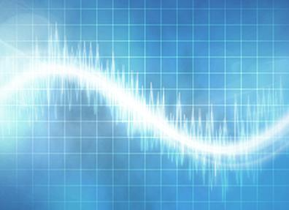
Key Measurement Components of a DAQ Device
Signal Conditioning:
Signals from sensors or the outside world can be noisy or too dangerous to measure directly. Signal conditioning circuitry manipulates a signal into a form that is suitable for input into an ADC. This circuitry can include amplification, attenuation, filtering, and isolation. Some DAQ devices include built-in signal conditioning designed for measuring specific types of sensors.

Slide 8
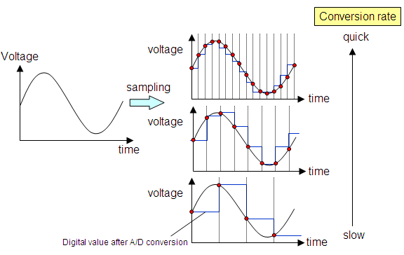
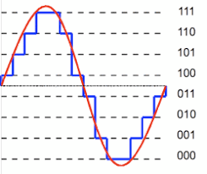
Key Measurement Components of a DAQ Device
Analog-to-Digital Converter (ADC):
Analog signals from sensors must be converted into digital before they are manipulated by digital equipment such as a computer. An ADC is a chip that provides a digital representation of an analog signal at an instant in time. In practice, analog signals continuously vary over time and an ADC takes periodic “samples” of the signal at a predefined rate. These samples are transferred to a computer over a computer bus where the original signal is reconstructed from the samples in software.

Slide 9
Computer Bus: Wired and Wireless
DAQ devices connect to a computer through a slot or port. The computer bus serves as the communication interface between the DAQ device and computer for passing instructions and measured data. DAQ devices are offered on the most common computer buses including USB, PCI, PCI Express, and Ethernet. More recently, DAQ devices have become available for 802.11 Wi-Fi for wireless communication. There are many types of buses, and each offers different advantages for different types of applications.

Slide 10
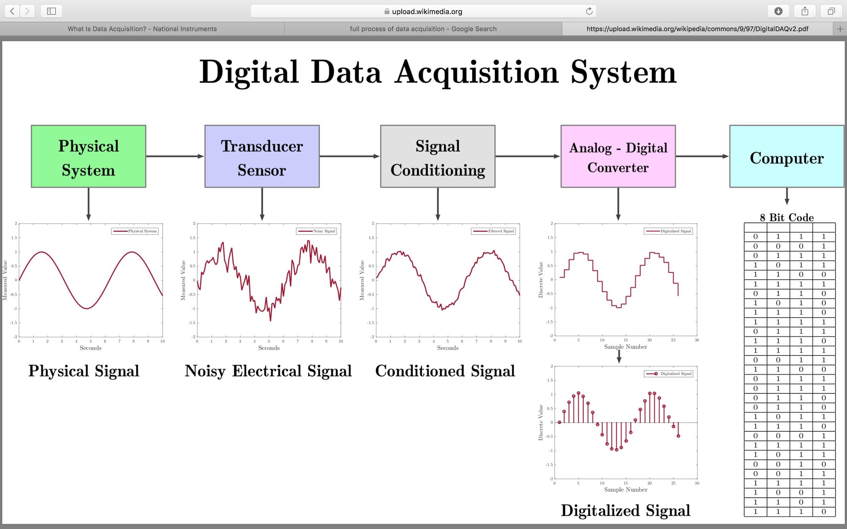

Slide 11
Advantages of Data Acquisition Systems
Reduced data redundancy
Reduced updating errors and increased consistency
Greater data integrity and independence from applications programs
Improved data access to users through use of host and query languages
Improved data security
Reduced data entry, storage, and retrieval costs
Facilitated development of new applications program

Slide 12
Disadvantages of Data Acquisition Systems
Database systems are complex, difficult, and time-consuming to design Substantial hardware and software start-up costs
Damage to database affects virtually all applications programs
Extensive conversion costs in moving form a file-based system to a database system Initial training required for all programmers and users

Slide 13
References:
National Instruments: http://www.ni.com/data-acquisition/what-is/
BrainKart : http://www.brainkart.com/article/Advantages--Disadvantages-and-Applications-of-Data-Acquisition-Systems_12771/
WikiPedia : https://en.wikipedia.org/wiki/Data_acquisition

Slide 14
Our Project:
Sensors (like Moisture, Humidity, Temperature etc sensors) values are collected. Depending on the sensor the data is Analog or Digital Value. If analog, it has to be converted to digital for transmission and handling of data by the computer (MCU here).
Now, the digital data (in Bits) is concatenated to form a single array, that helps in the efficient transmission of data.
The concatenated data array is sent using the wireless methods (We will discuss) (RF, Bluetooth, LoRa).
Receive at the Receiver end and slice the data to obtain the individual data points to analyse the status.

Slide 15
Thank you

